Slide 1


IMAGE CLASSIFICATION ON CIFAR-10
INSTRUCTOR: Mehdi ZARGHAM
-Karthik nimma
-Maheen tanveer

Slide 2
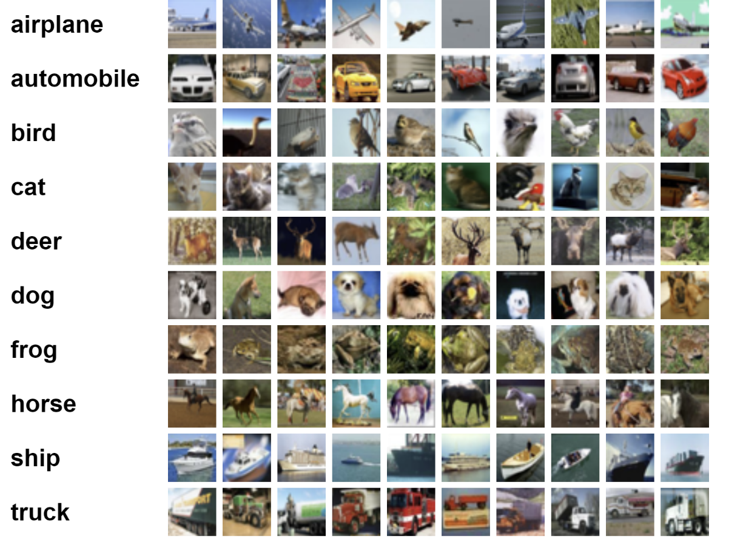
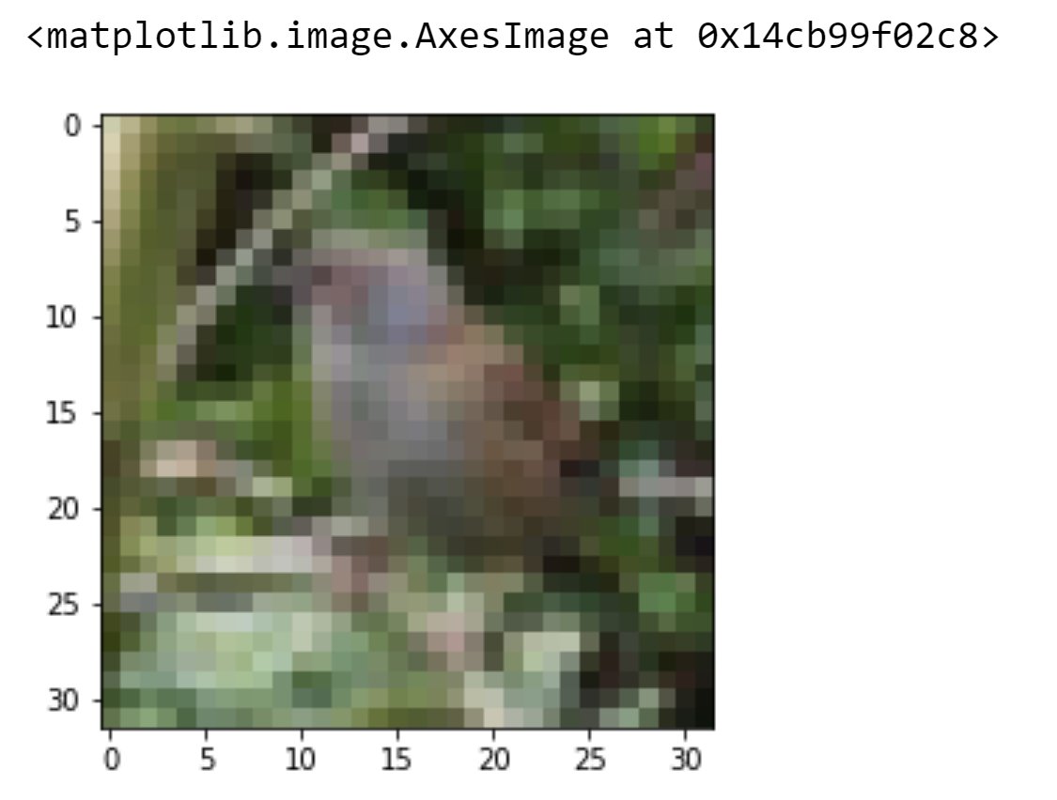
CIFAR-10 DATASET
Total: 60,000 images
Image size: 32x32
Each class: 6000 images
Training: 50,000
Testing : 10,000

Slide 3
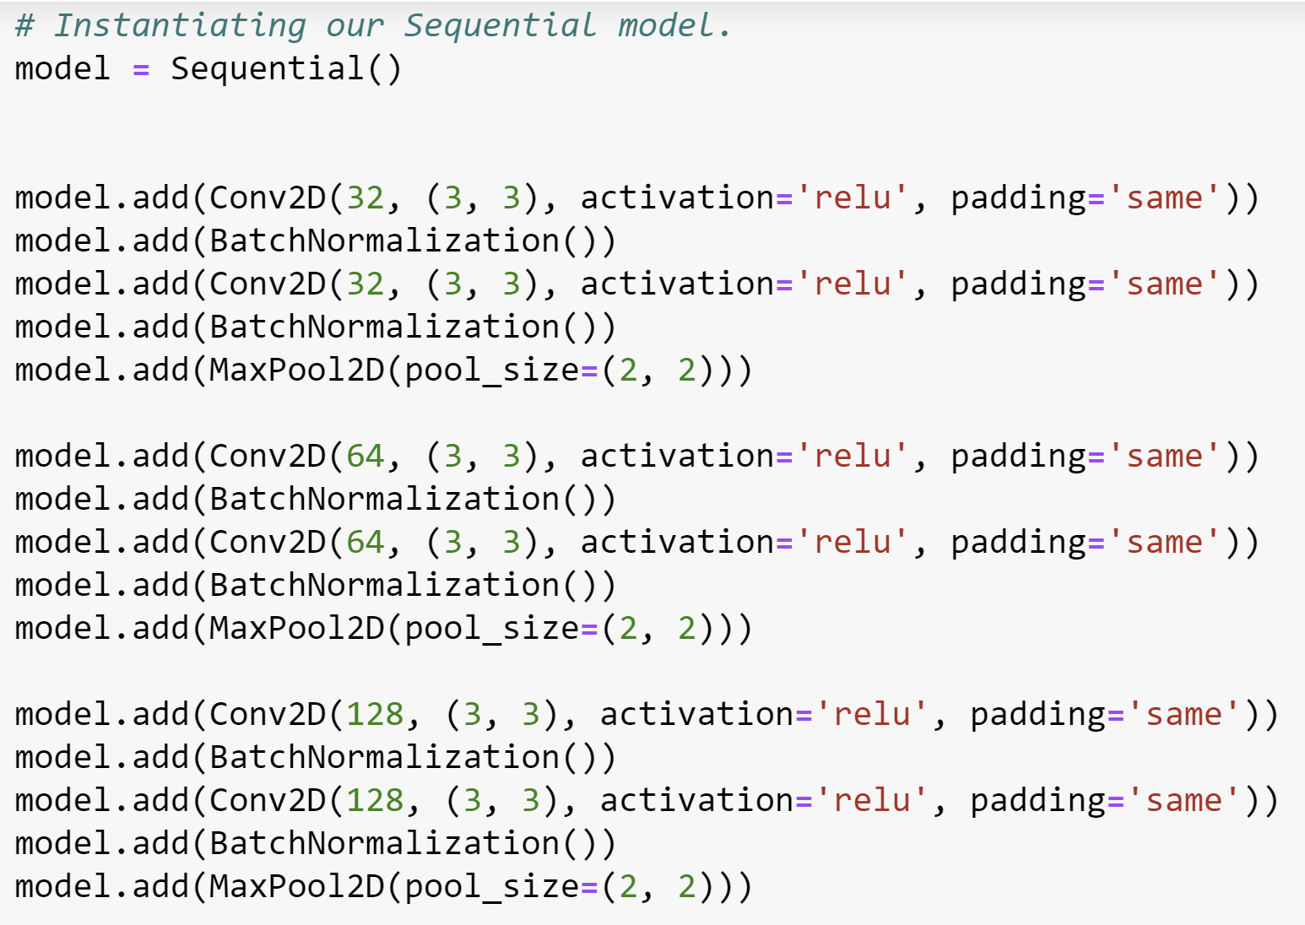
CNN
BatchNorm
CNN
BatchNorm
Maxpooling 2x2
x3

Slide 4
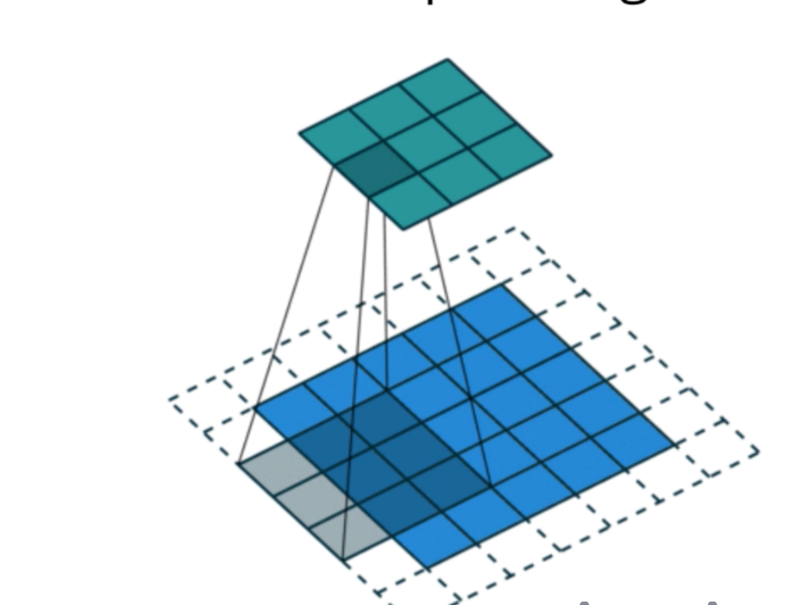
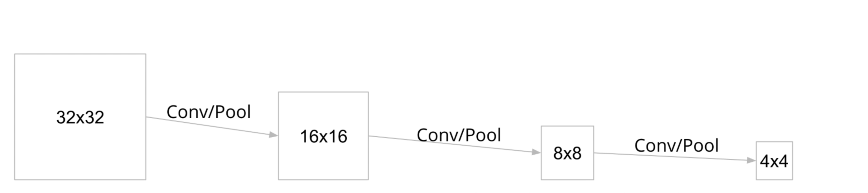
Padding helps to maintain the same output dimensions after each convolution.
With padding=‘same’
Without padding

Slide 5
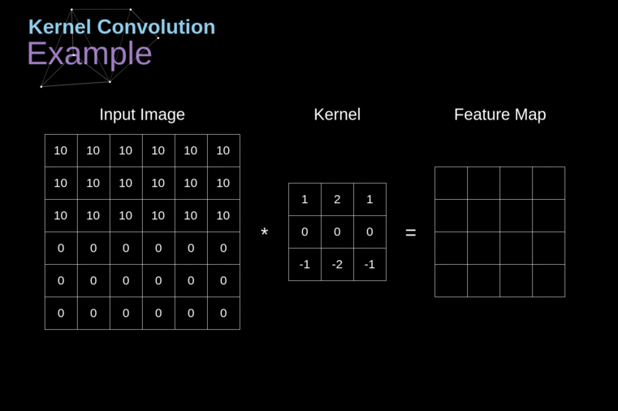

Slide 6
Batch Normalization
Since outliers rarely occurs, we can safely assume that in a batch the affect of outliers will be compensated if we normalize. By batch normalization, the outlier activations are reduced. Hence higher learning rates can be used to accelerate the learning process.

Slide 7
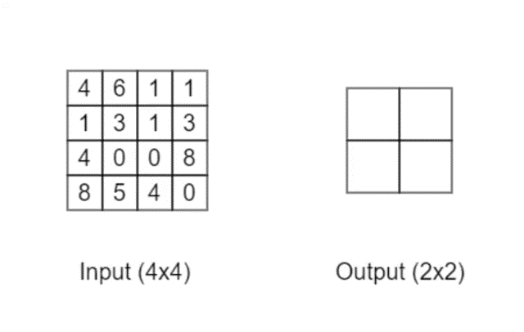
MAX POOLING
Max pooling is used for down sampling. It will take each two by two square of which there are four and just return the maximum value in each of those squares. Max pooling layer recognizes certain features no matter in whatever shape and size the input has been given.

Slide 8
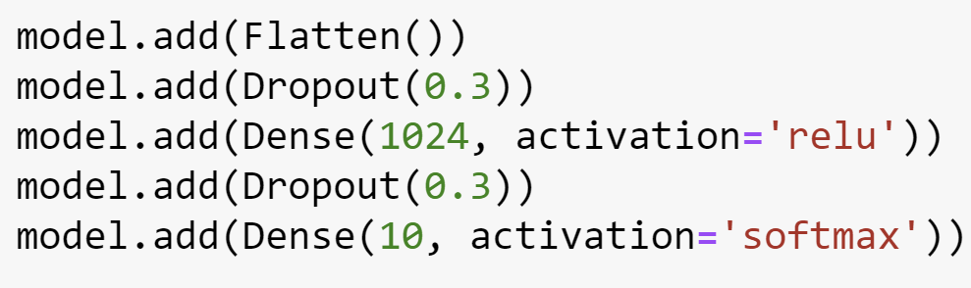
DENSE NEURAL NETWORK
The hidden layer contains 1024 neurons which are connected to 10 neurons in the output layer. The number of neurons in the output layer equals the total number of classes.
Dropout technique is used to prevent the model from overfitting. This is achieved by randomly turning of few neurons in a layer. We have set the dropout probability to 0.3

Slide 9
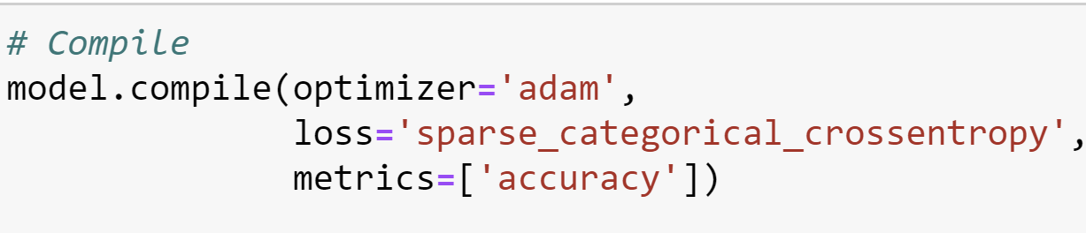
Model.Compile!
Adam changes the gradient in an adaptive fashion.
Spare Categorical CrossEntropy is used because we have encoded class labels as normal integers.

Slide 10
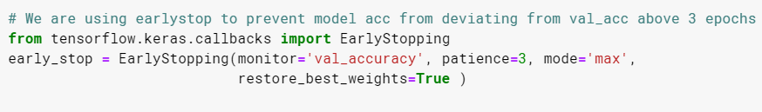
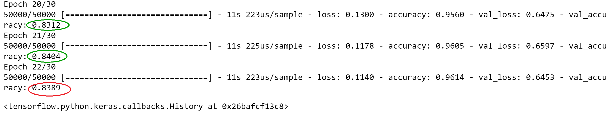
EARLY STOPPING

Slide 11
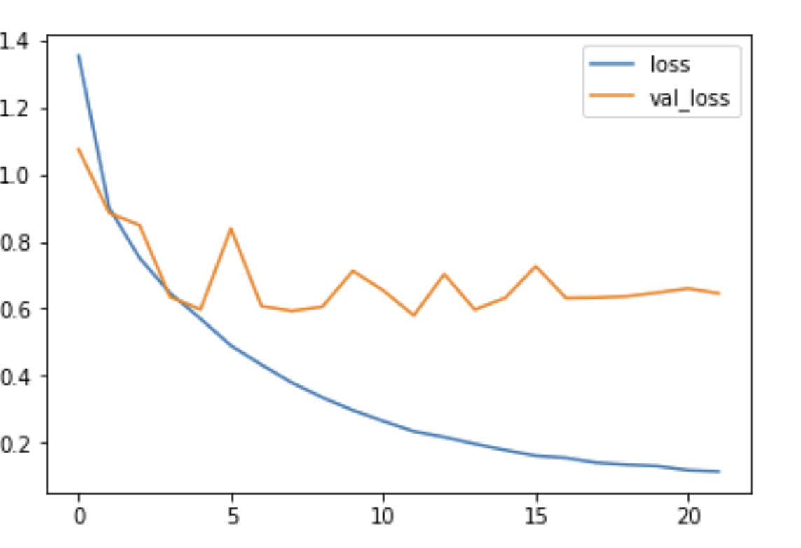
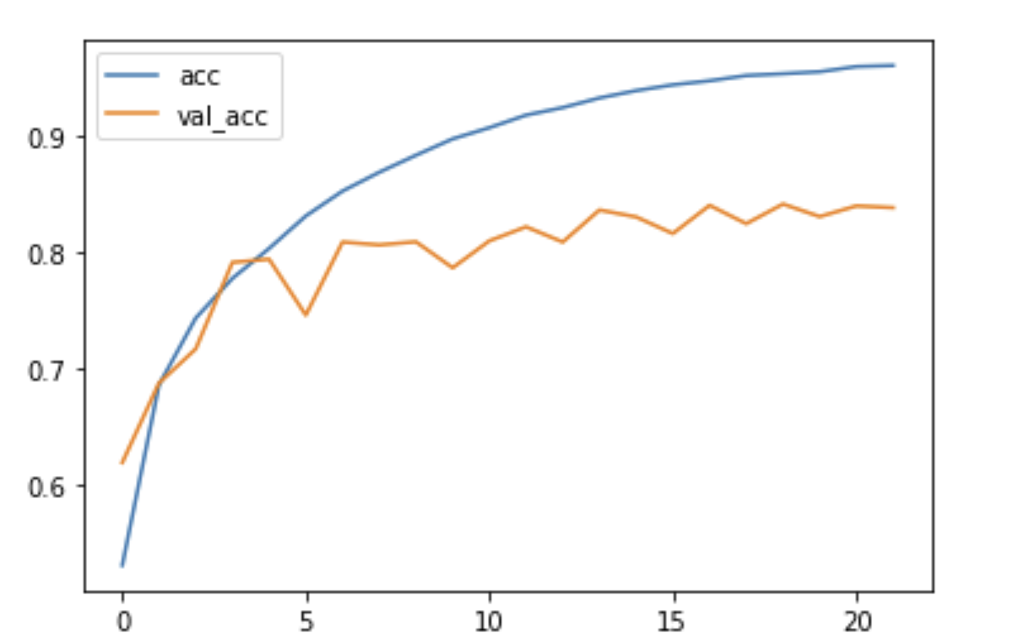
Loss – 0.18
Val_loss – 0.75
Without Augmentation
Accuracy – 97.2%
Val_Acc – 81.78%

Slide 12
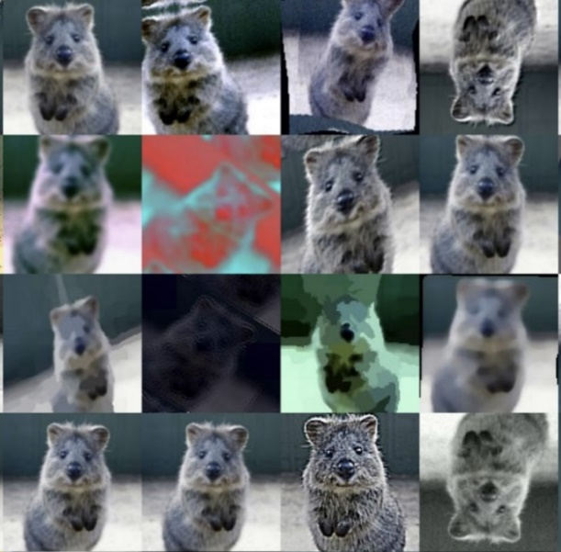
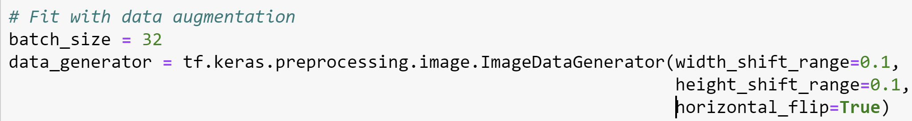
Let’s Improve our model
Deep learning algorithms often perform better with more data.
Data augmentation artificially creates new data, derived from the given data set to help generalize the model.

Slide 13
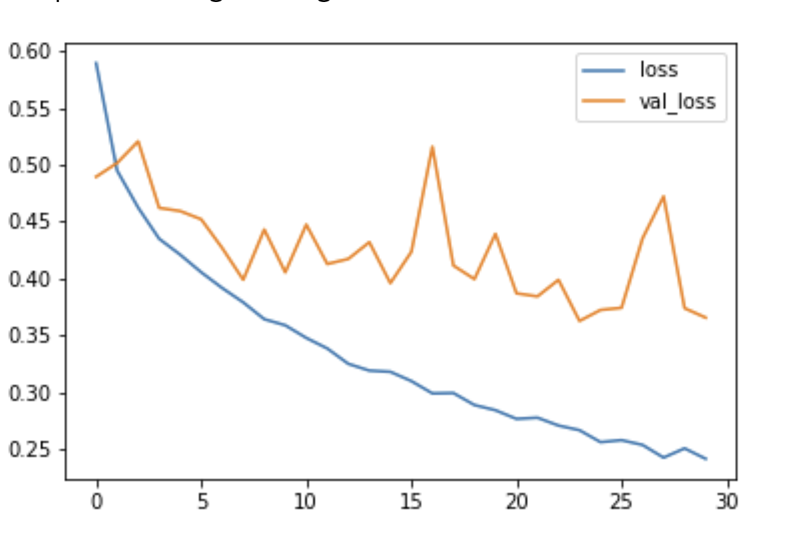
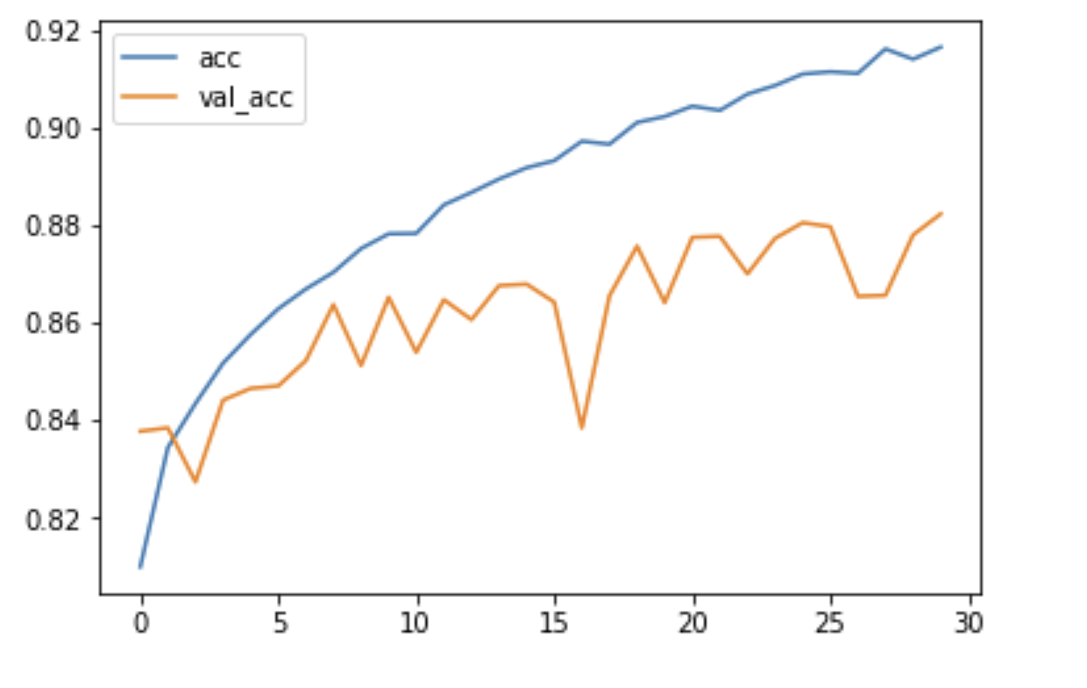
Loss – 0.26
Val_loss – 0.37
With Augmentation
Accuracy – 91.8%
Val_Acc – 88.1%

Slide 14
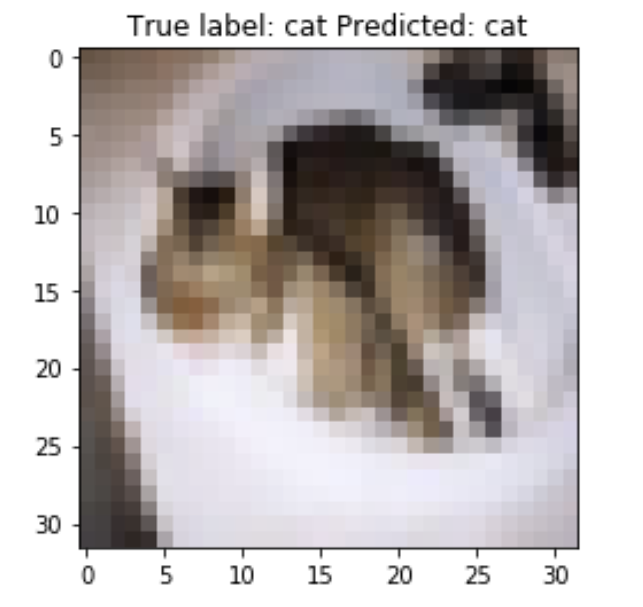
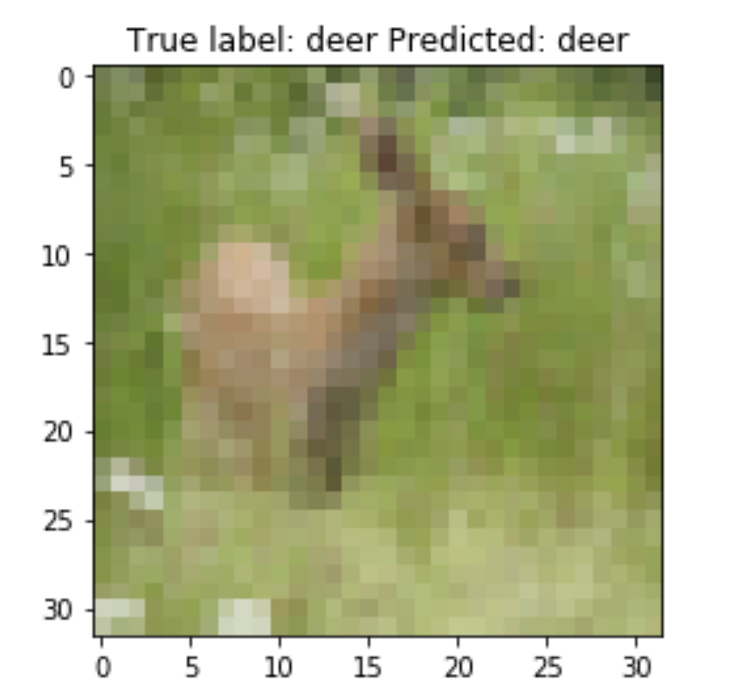
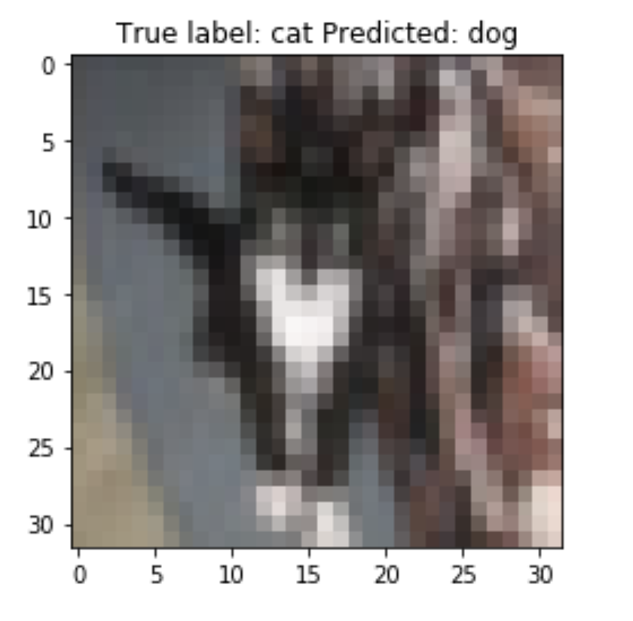
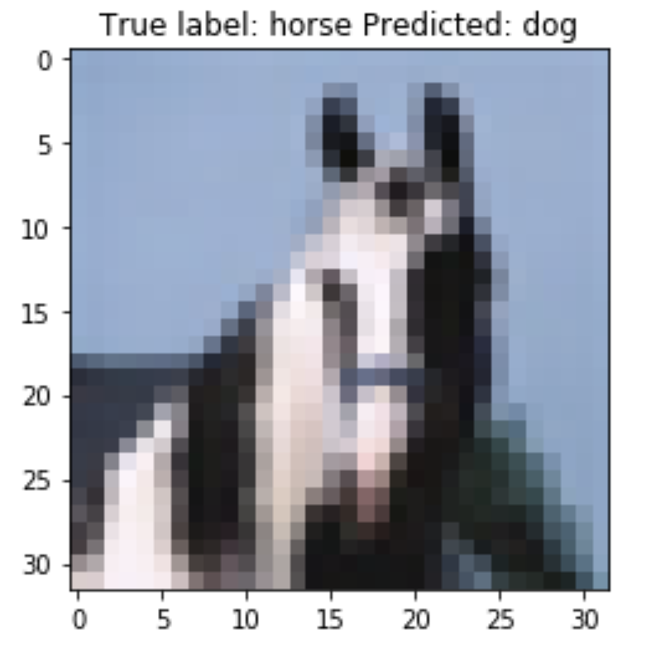
Correctly Classified
Misclassified

Slide 15
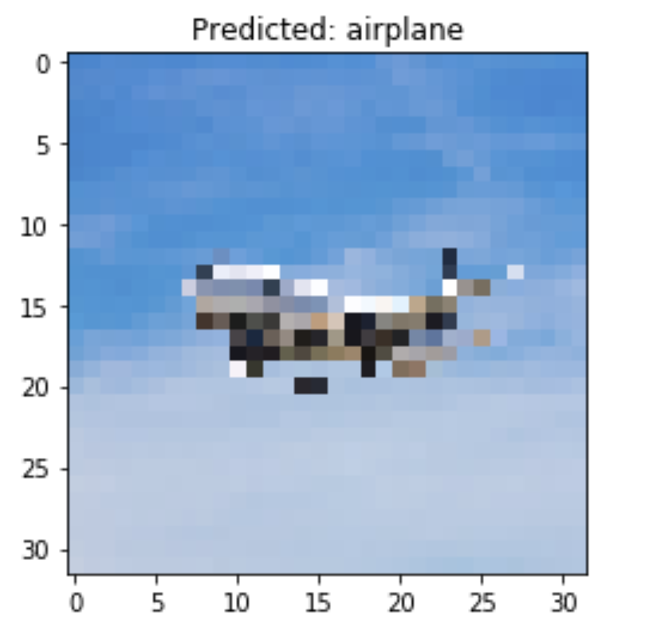
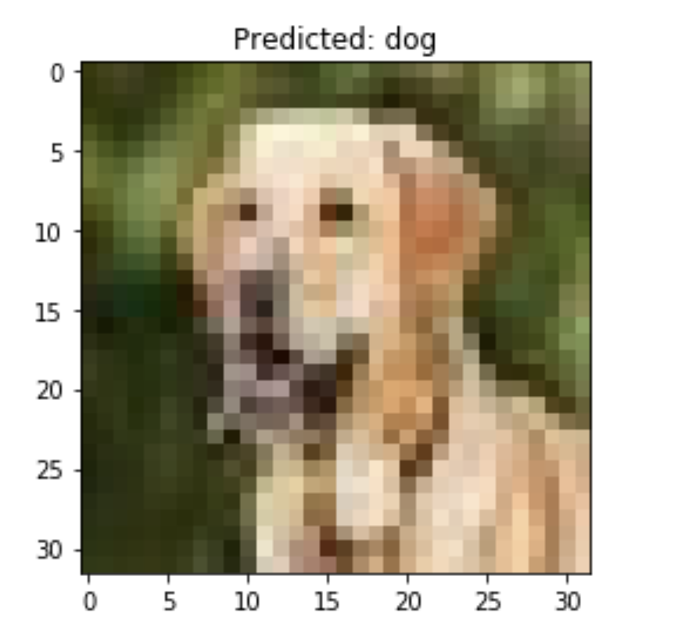
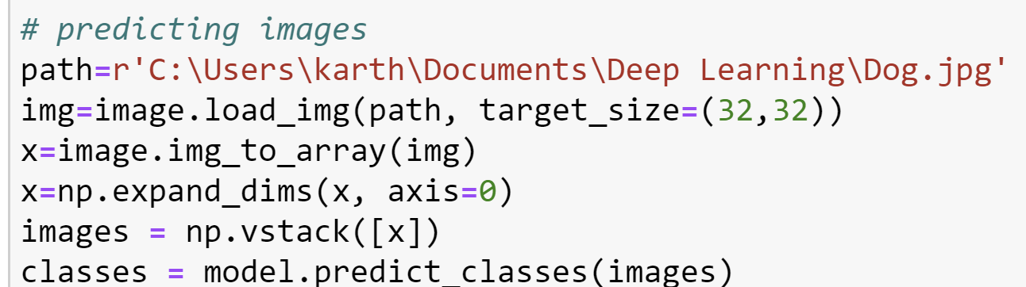

Slide 16
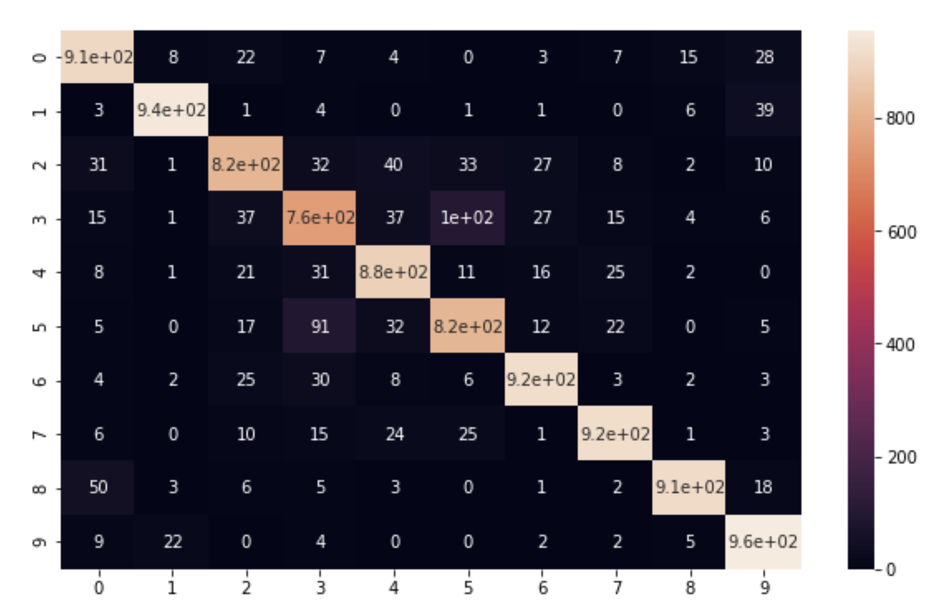
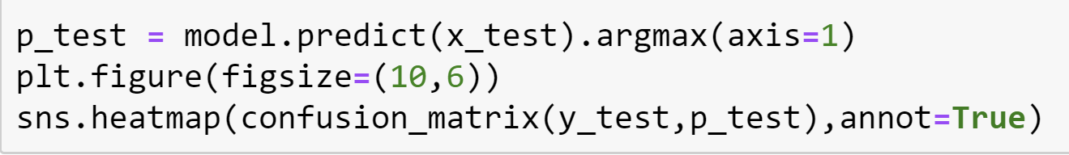
CONFUSION MATRIX
Confusion matrix helps visualize how accurate our model is in classification.
The confusion matrix suggests that model classifies with very high accuracy in most cases.
The bright diagonal represents correctly classified images

Slide 17
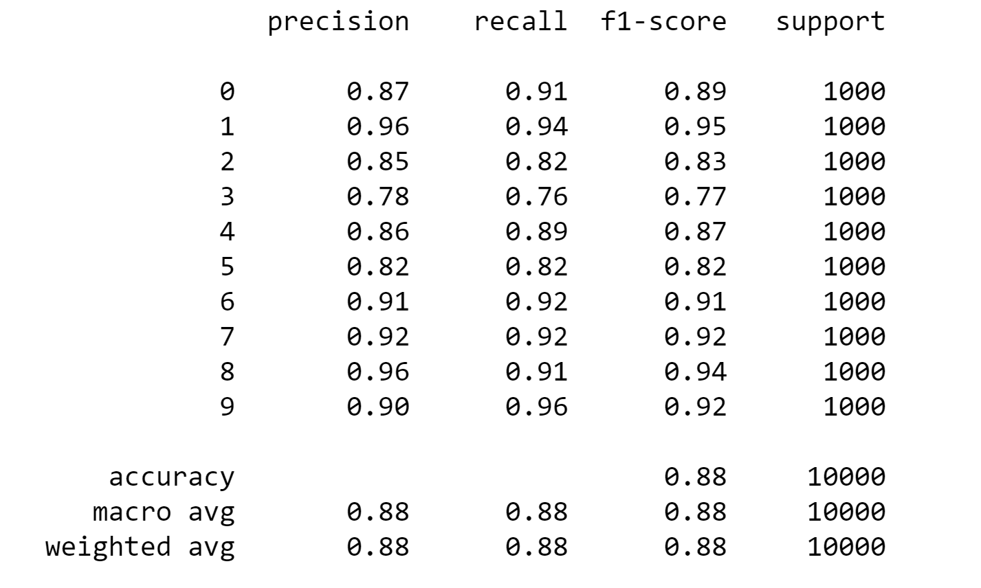
Classification Report
Precision — What percent of your predictions were correct?
Recall — What percent of the positive cases did you catch?
F1 Score – Higher the better
Support is the number of occurrence of the given class in your dataset

Slide 18
Conclusion
We conclude that overfitting is a major problem in deep learning. we have overcome this problem by following various techniques such as dropouts, image augmentation and callbacks. Each of these techniques is context dependent so there is no universal way of doing things to prevent overfitting. these techniques helped to reach very low validation loss and a higher validation accuracy.

